Slide 1
An Internet Latency Measurement Study
Ben Zhang
Ahir Reddy
CS268 Spring 2013
Notes:
Intro

Slide 2
Problem
We seek to measure and characterize latency as it relates to:
Wide Area Networks
Data Centers*
Cellular Networks
* Not latency inside DC, rather a comparison to WAN

Slide 3
Motivation
Understanding state-of-art Internet latency
In comparison to speed-of-light limit
Geographical correlation (Latency vs. Distance)
Latency experienced by end user in the following model
User ----> WAN ----> DC ----> WAN ----> User
Discover the fraction of latency on WAN and inside DC
Unclear cellular latency dynamics
Mobile users experience long latency due to the setup time or long paths (travel to undesired place first)
How the signal strength, load balancing affect latency experienced by users is unknown
Notes:
Slide #2: Motivate your project by describing why its solution is important. Who would care if you are successful and why?

Slide 4
Prior Work
End-to-end latency measurement (no recent studies)
King, T-King methods for arbitrary two hosts (DNS recursive query)
Vern’s work on end-to-end dynamics (~1995)
Datacenter Application Deadline (no comparison to WAN latencies)
[Sigcomm’ 11 Better Never than Late]
[Sigcomm’ 12 DeTail]
Cellular Network (no dynamics analysis)
[Sigmetrics’ 11 Xu] Cellular network infrastructure study
[MobiPerf] A lightweight mobile application for measurement
Notes:
Slide #3: Describe prior work. If your problem is so important, why hasn't it been solved already? What has already been done and where does it fall short?

Slide 5
Approach
WAN
Measurement methodologies are based on the King/T-King methods (recursive DNS query)
Do a continuous study on a daily/weekly basis
Use various techniques to infer DNS server locations and perform correlation
Filter out DNS forwarders that would otherwise skew results
Use Geo-IP to build latency vs. distance graph
DC
Use ping to get RTT
Perform Query to determine DC time (Query Time – Ping RTT)
Random Queries
Hot Trends
Google’s provided estimated query time
Mobile
Trick: use USB tethering so that various tools on PC can be used easily for measurement
Use traceroute to reverse engineer network topology

Slide 6
Turbo King – Setup
Crawl of reverse DNS Tree
236,000 DNS servers discovered
26,000 Open Recursive Resolvers (distribution on next slide)
Turbo King Infrastructure
56 Measurement Nodes (Planet Lab)
2 Central Name Servers (EC2)
Measurement nodes controlled via RPCs
Issue command measurement command (NS1, IP1, NS2, IP2)
Receive Latency results and presence of DNS Forwarder
8 days: 4/20 – 4/28 (ongoing)
~4.95 Million successful measurements
Notes:
Slide #2: Motivate your project by describing why its solution is important. Who would care if you are successful and why?

Slide 7
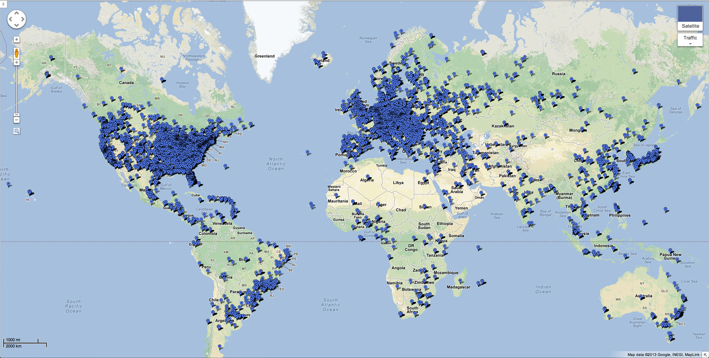
Turbo King – Open Resolvers
Notes:
Slide #2: Motivate your project by describing why its solution is important. Who would care if you are successful and why?
----- Meeting Notes (5/1/13 12:13) -----
Select points

Slide 8
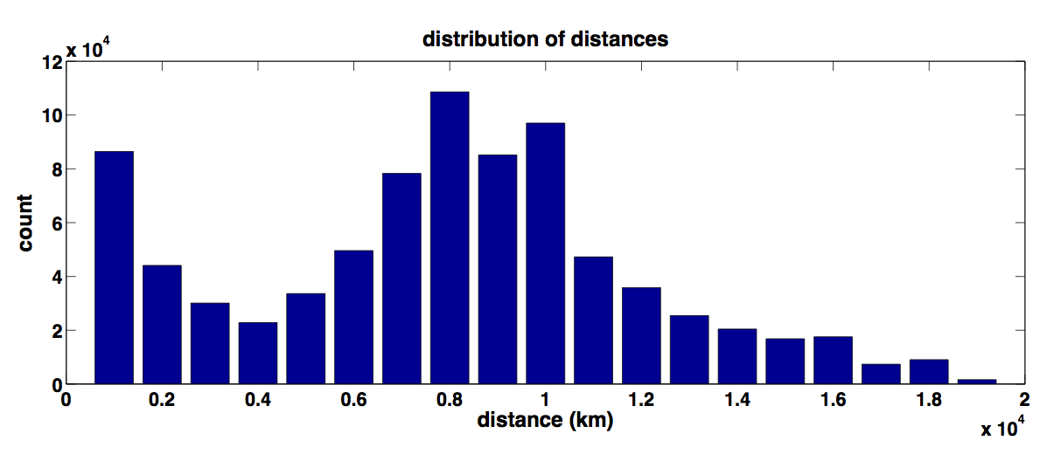
Turbo King – Distance Distribution
Notes:
Slide #2: Motivate your project by describing why its solution is important. Who would care if you are successful and why?

Slide 9
Turbo King (Modified)
Resolve:
qid.myAddr.mydomain.com
Resolve:
qid.myAddr.mydomain.com
myAddr
1
ns.target1.com
(target 1)
ns.target2.com
(target 2)
DNS Client
6
8
NXDomain
Referral:
ns.target2.com
DNS Server
5
NXDomain
4
7
Resolve:
qid.myAddr.mydomain.com
2
Resolve:
qid.myAddr.mydomain.com
ns.mydomain.com
Referral:
myAddr
5
8
Record time delta T between and
Determine RTT between myAddr and target1
Latency target1 to target2 = T – RTT
3
Notes:
Slide #2: Motivate your project by describing why its solution is important. Who would care if you are successful and why?

Slide 10
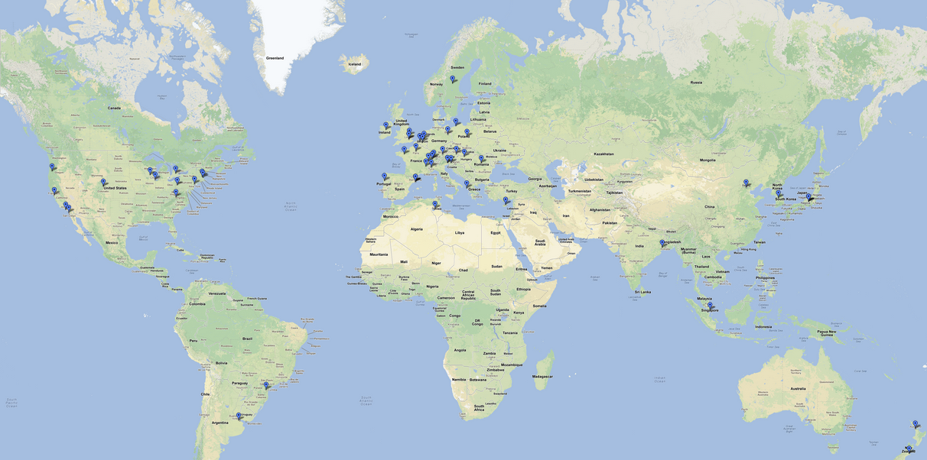
Turbo King – Planet Lab Nodes
Notes:
Slide #2: Motivate your project by describing why its solution is important. Who would care if you are successful and why?

Slide 11
Turbo King – Analysis
Distribution of Distances
Intercontinental patterns
Filter
Measurements faster than speed of light (~90,000)
Incorrect Geo IP
Negative Latency (~41,000)
Still analyzing
Extremely High Latencies (~240,000)
5 second timeout
Results returned by forwarders (~1,140,000)
Zero Distance (~22,000)
First Result of DNS Query to new server (~2,400,000)
Extra latency introduced by DNS resolution of our domain
Reduce 4.95 Million to 1 Million
DNS Forwarders
Large Impact on Results
Nearly 25% of all queries returned by forwarders
Notes:
Slide #2: Motivate your project by describing why its solution is important. Who would care if you are successful and why?

Slide 12
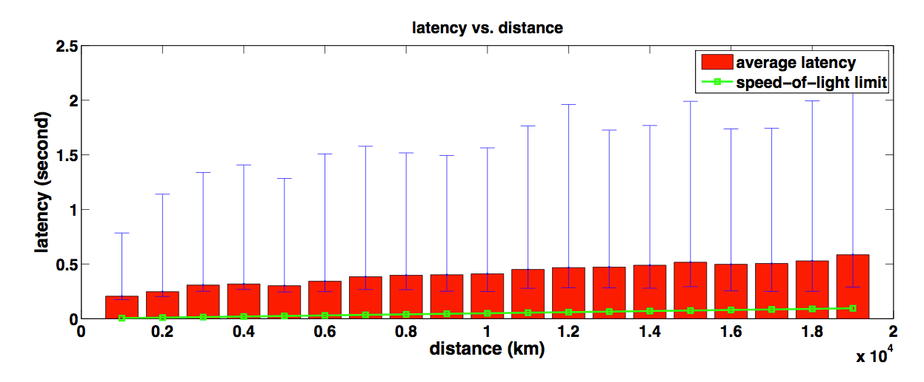
Turbo King – Latency vs. Distance
Notes:
Slide #2: Motivate your project by describing why its solution is important. Who would care if you are successful and why?

Slide 13
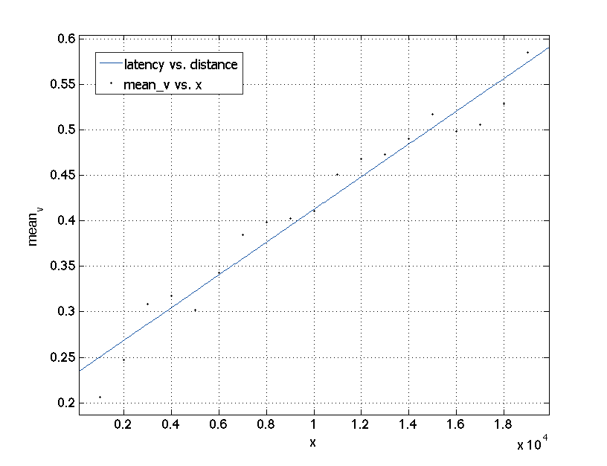
Turbo King – Latency vs. Distance
f(x) = p1*x + p2
Coefficients (with 95% confidence bounds):
p1 = 1.798e-05 (1.604e-05, 1.992e-05)
p2 = 0.2326 (0.2104, 0.2547)
Goodness of fit:
SSE: 0.008216
R-square: 0.9573
Adjusted R-square: 0.9548
RMSE: 0.02198
Notes:
Slide #2: Motivate your project by describing why its solution is important. Who would care if you are successful and why?

Slide 14
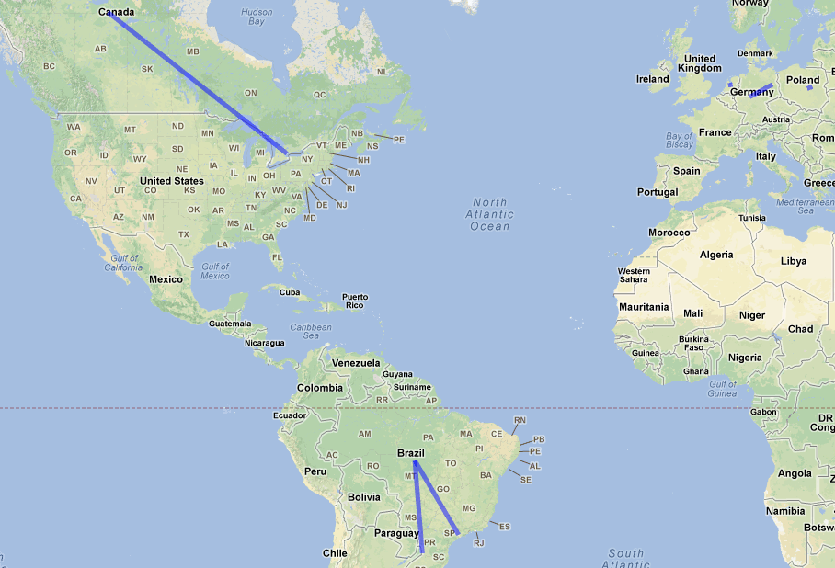
Turbo King – DNS Forwarders
Notes:
Slide #2: Motivate your project by describing why its solution is important. Who would care if you are successful and why?

Slide 15
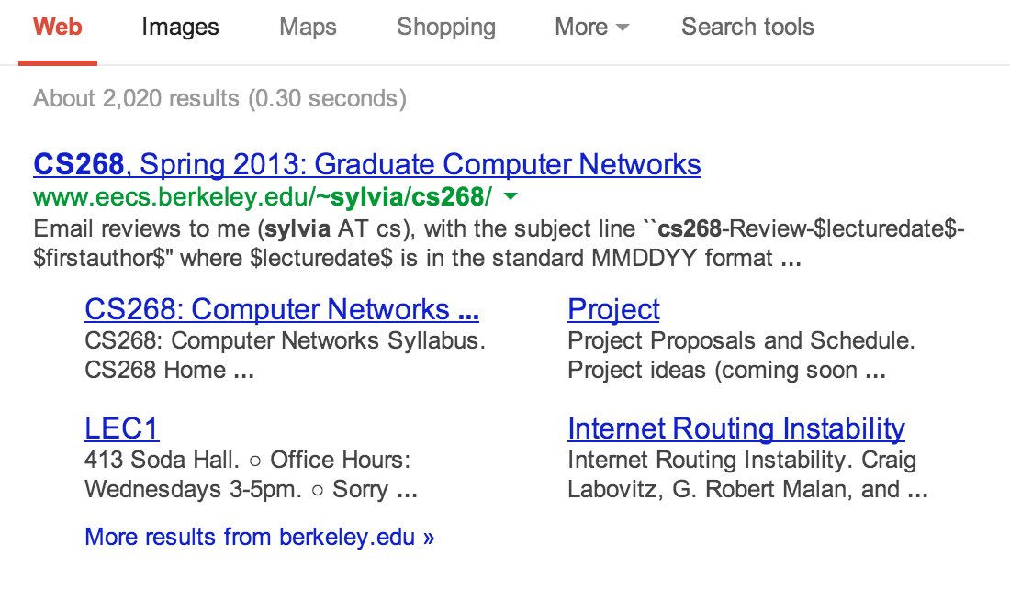
Data Center
Recap Strategies – Query Google
Query the hottest trend of that hour
Query Random Strings
Ping responded Google IP
tcpdump to parse the packet
From 19 PlanetLab nodes (13 valid)
'Richie Havens ’
'jthYj3KCeqbZAja9Pl2FUOMQIE8K7zZI ’
'Katherine Russell Tsarnaev ’
'pOGwlAa14a8HWaLCyyTpPWB6pd713ITG ’
'CISPA ’
'OYYWPFn0DJg2jdr3lr99LL2jwPG8W1Lq ’
'After Earth ’
'eo0kuaGsHnKxssZFGlivLNMh18RMddTL ’
…
Four different “time”:
hot-trend query time
random query time
ping time
google time
Notes:
RFC 1918
172.16.0.0 - 172.31.255.255 (172.16/12 prefix)

Slide 16
Data Center
Notes:
Median value
*Argument to make:
1, Random is shorter than hot trends? (Not cached?) 2, Google Portion is not trivial (DC optimization is still needed)

Slide 17
[AS0] 172.20.10.1
~0.7 ms
Mobile Networks
[AS16509] 172.26.236.2
~35 ms
[AS16509] 172.26.241.133
~35 ms
Recap Strategies – Traceroute
from 1 AT&T iPhone (tethering)
to ~1000 top websites
at various time (2013/04/12-2013/04/24)
[AS0] 172.26.96.10/172.26.96.11
172.26.96.3/172.26.96.2
~35 ms
[AS0] 172.26.96.193
~35 ms
What we expect:
Latency on each hop
Routing stability within AT&T cellular backbone
[AS0] 172.16.121.113
~35 ms
[AS7018] 12.249.2.49
~40ms
[AS7018] 12.83.180.82
~50ms
[AS7018]
12.122.200.9/12.122.114.5
12.122.1.118/12.122.8.79…
50ms -
100 ms
[AS7018]
12.122.114.21/12.123.30.5
[AS0]
192.205.33.46/…
50 ms -
100 ms
Possibly Internet…. 50 ms – 200 ms
Notes:
RFC 1918
172.16.0.0 - 172.31.255.255 (172.16/12 prefix)
Quick note on the first hop (iPhone)
Second hop: Packet Data Gateway

Slide 18
Mobile Networks (latency)
Notes:
Arguments to make: 1) fairly stable within cellular.
2) Still latency not too small

Slide 19
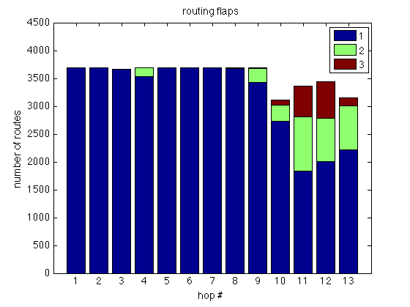
Mobile Networks (route flaps)
Notes:
For each traceroute, the number of responds

Slide 20
Mobile Networks (“mobile”)
Notes:
Fall back to 4G network in this case

Slide 21
Questions & Feedback?
Thank you!

Slide 22
Backup Slides

Slide 23
Mobile Networks (exit point)
% traceroute -a reference.com
traceroute to reference.com (66.235.120.211), 64 hops max, 52 byte packets
1 [AS0] 172.20.10.1 (172.20.10.1) 0.927 ms 0.642 ms 0.477 ms
2 [AS16509] 172.26.242.133 (172.26.242.133) 36.689 ms 30.317 ms 35.074 ms
3 [AS16509] 172.26.236.2 (172.26.236.2) 25.838 ms 29.971 ms 31.606 ms
4 [AS0] 172.26.96.2 (172.26.96.2) 28.391 ms 27.886 ms 29.280 ms
5 [AS0] 172.26.96.193 (172.26.96.193) 30.280 ms 49.540 ms 28.846 ms
6 [AS0] 172.16.120.50 (172.16.120.50) 35.119 ms 31.004 ms 32.317 ms
7 [AS7018] 12.249.2.53 (12.249.2.53) 26.373 ms 34.862 ms 32.519 ms
8 [AS7018] 12.83.180.94 (12.83.180.94) 103.892 ms 107.387 ms 113.005 ms
9 [AS7018] cr1.sffca.ip.att.net (12.122.3.69) 106.870 ms 95.033 ms 104.060 ms
10 [AS7018] cr1.cgcil.ip.att.net (12.122.4.122) 109.386 ms 106.220 ms 108.469 ms
11 [AS7018] cr2.wswdc.ip.att.net (12.122.18.22) 100.918 ms 102.278 ms 103.591 ms
12 [AS7018] 12.123.10.137 (12.123.10.137) 97.787 ms 104.401 ms 102.540 ms
13 * * *
14 [AS10913] border10.pc1-bbnet1.wdc002.pnap.net (216.52.127.9) 197.034 ms
[AS10913] border10.pc2-bbnet2.wdc002.pnap.net (216.52.127.73) 106.194 ms 105.049 ms
15 * * *

Slide 24
GeoIP accuracy (MaxMind)
Poor in general
We are using DNS servers
Relative stable, but uncertain
Country | Correctly resolved within forty kilometers | Incorrectly resolved | City is unknown
United States | 78% | 16% | 6%
Notes:
Slide #2: Motivate your project by describing why its solution is important. Who would care if you are successful and why?

Slide 25
iPhone compares with EECS
Notes:
Slide #2: Motivate your project by describing why its solution is important. Who would care if you are successful and why?

Slide 26
iPhone compares with EECS
Notes:
Slide #2: Motivate your project by describing why its solution is important. Who would care if you are successful and why?

